Slide 1
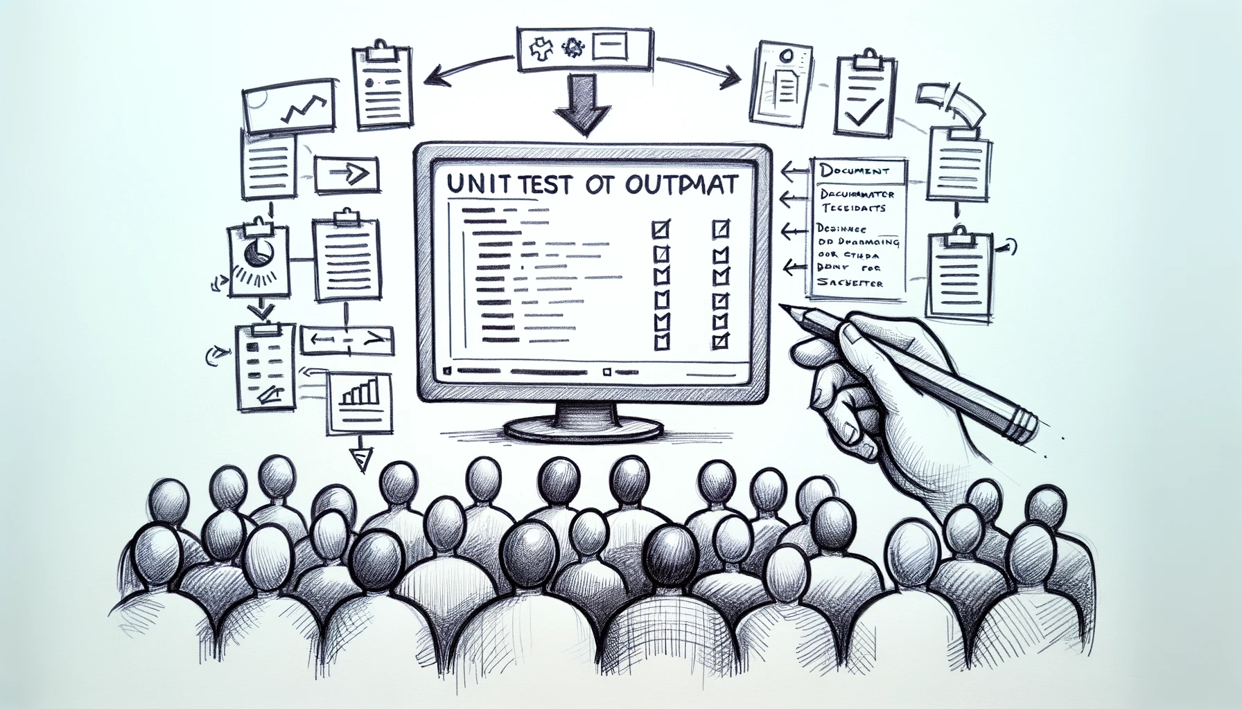
Better Testing with Approvals
Better Testing with ApprovalTests
Llewellyn Falco
Lada Kesseler
Llewellyn Falco
Lada Kesseler

Slide 2
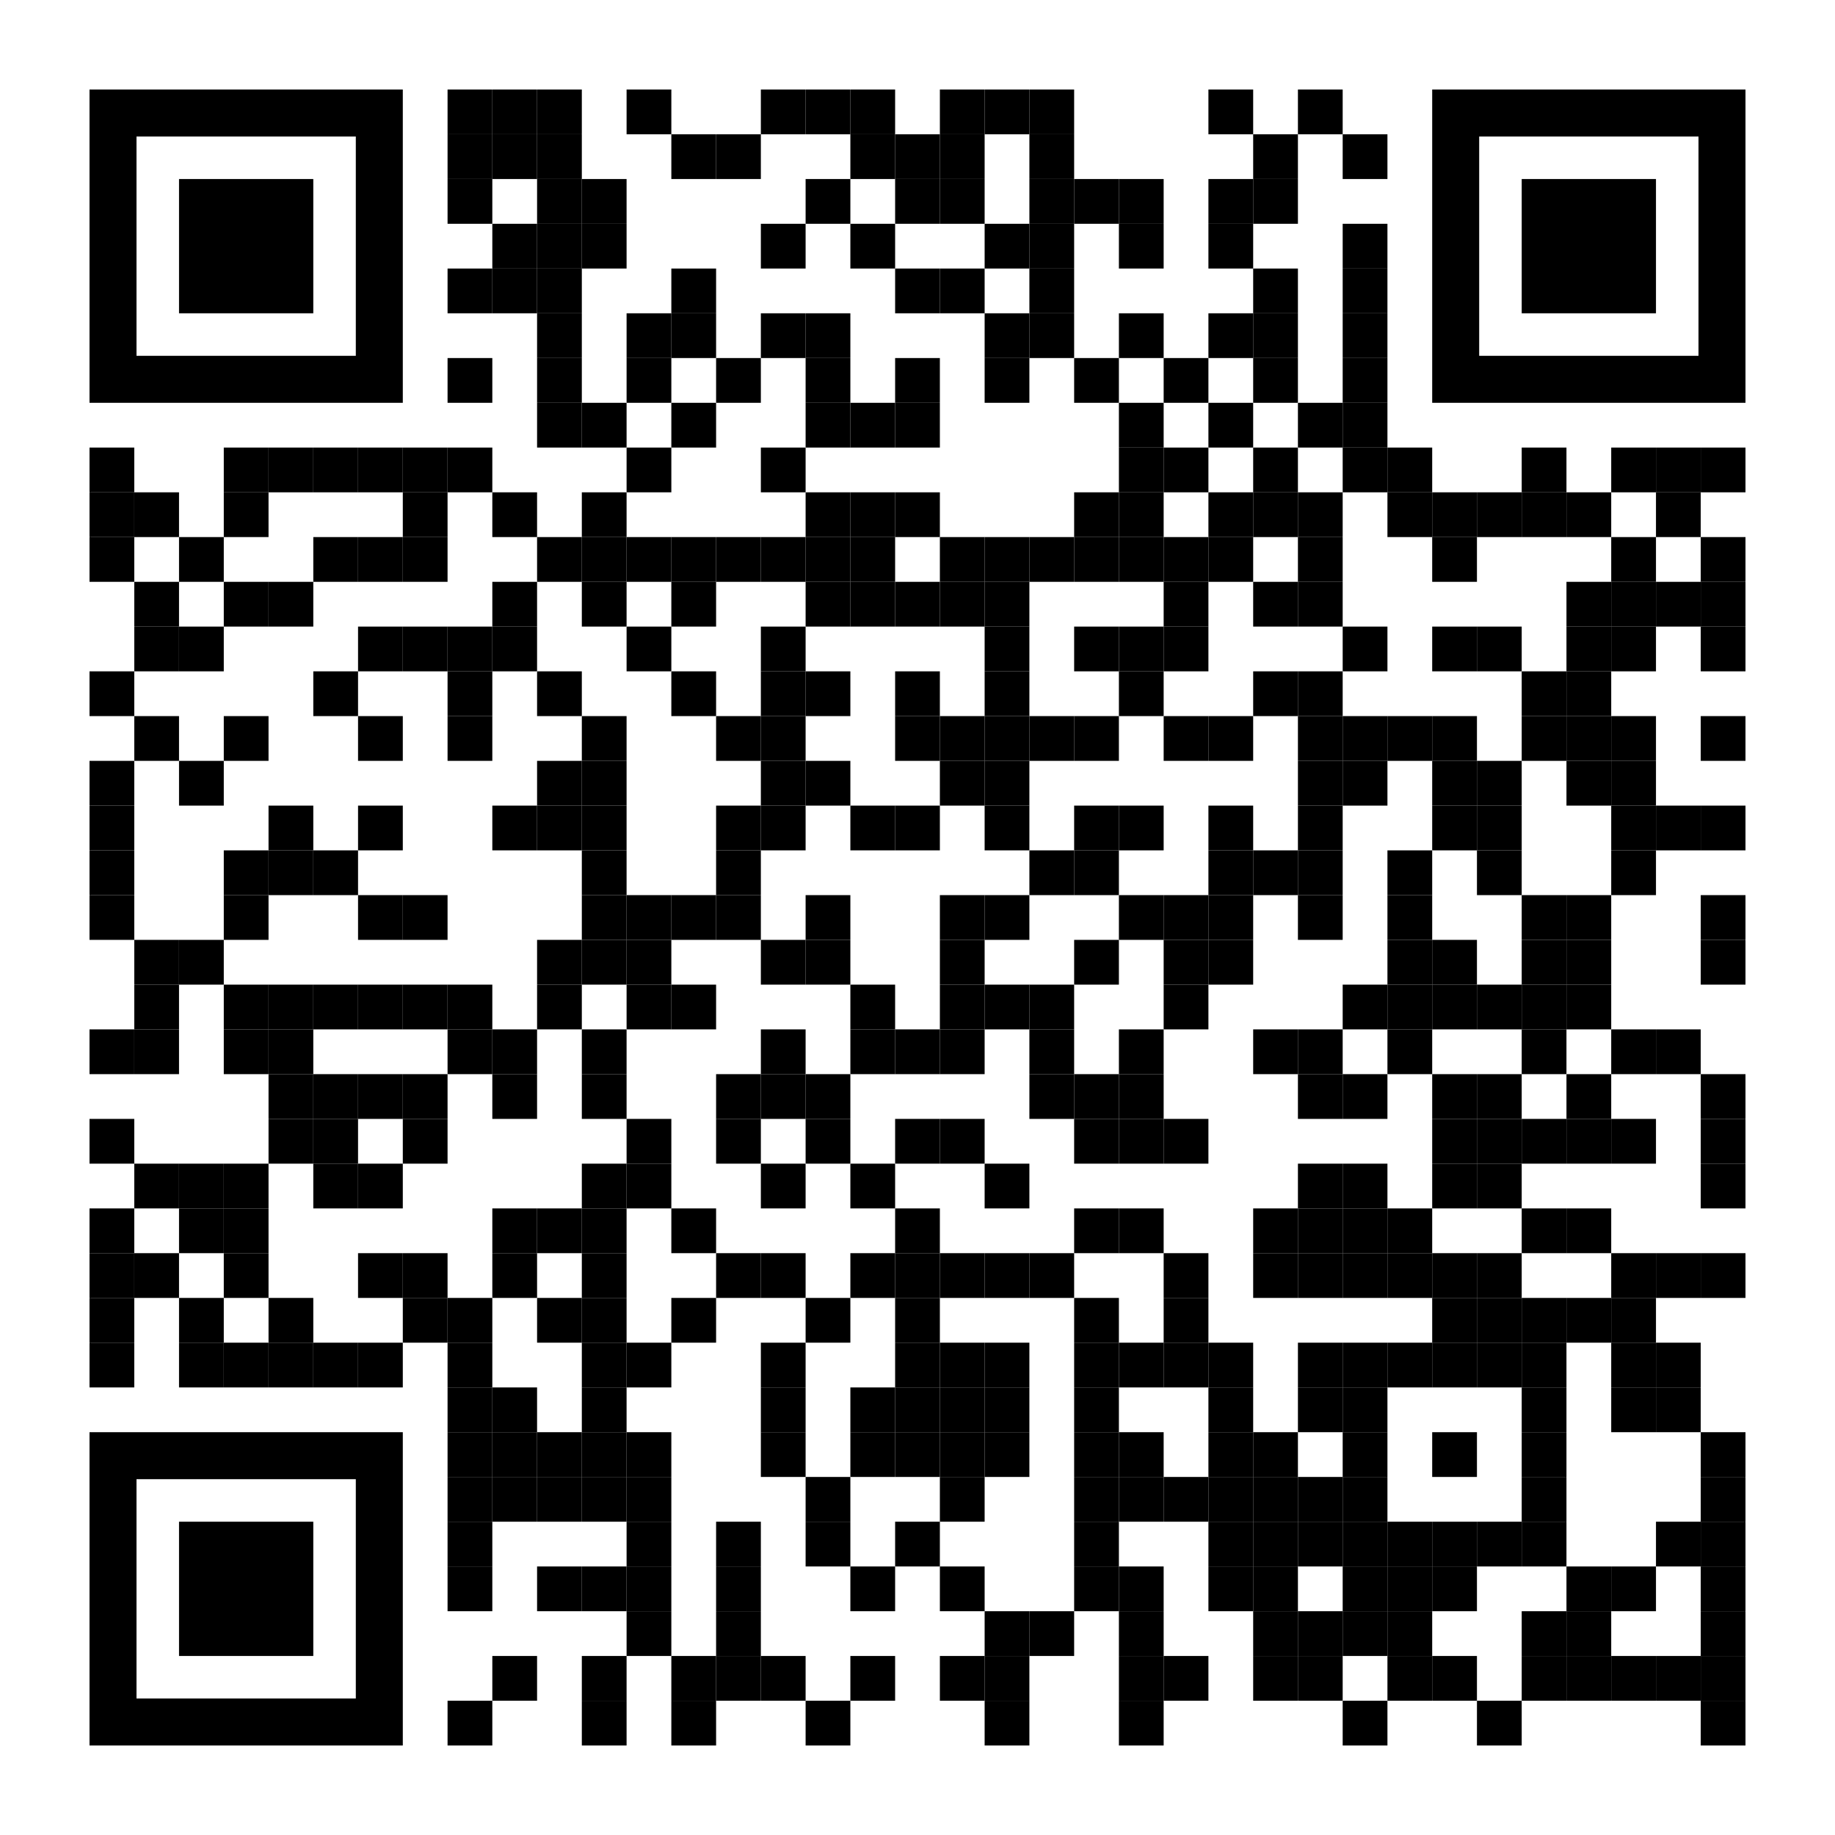
Resources
Notes:
https://github.com/isidore/Talks/blob/master/BetterTestingWithApprovals.md

Slide 3
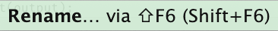
Housekeeping:
Presentation assistant

Slide 4

..
..
Clear
Expressive
Simple

Slide 5

In the beginning...

Slide 6
code

Slide 7
Problem:
What the test does is confusing

Slide 8
New Concept:
Testing Circle

Slide 9
// Create side (0,0) – (3,4)
// Verify length
Whiteboard
English
Testing Circle
Result
Code
Side (0,0) – (3,4) length = 5
Side s = new Side(0,0,3,4);
Approvals.Verify(s + “ length = “ +s.Length);

Slide 10
Chat
[Customer]
hi
[Bot]
Hi there! I'm your virtual assistant.
What would you like to do today?
Notes:
we put the focus on what it is that we're testing, and not the setup of the test

Slide 11
Chat
[Customer]
hi
[Bot]
Hi there! I'm your virtual assistant.
What would you like to do today?
Whiteboard
English
Testing Circle
Result
Code

Slide 12
Chat
[Customer]
hi
[Bot]
Hi there! I'm your virtual assistant.
What would you like to do today?
// customer says ‘hi’
// verify conversation
Whiteboard
English
Testing Circle
Result
Code

Slide 13
Chat
[Customer]
hi
[Bot]
Hi there! I'm your virtual assistant.
What would you like to do today?
// customer says ‘hi’
// verify conversation
Whiteboard
English
Testing Circle
Result
Code
String userMessage = "hi"; verifyConversation(userMessage);

Slide 14
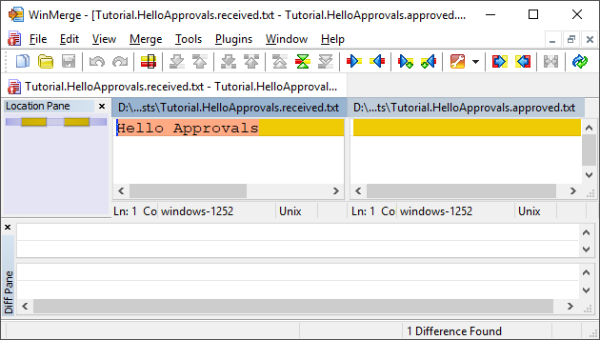
New Concept:
Approval Tests
Test + approved output

Slide 15
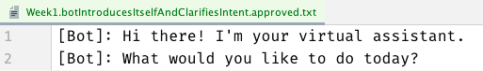
Chat
[Customer]
hi
[Bot]
Hi there! I'm your virtual assistant.
What would you like to do today?
// customer says ‘hi’
// verify conversation
Whiteboard
English
Testing Circle
Result
Code
String userMessage = "hi"; verifyConversation(userMessage);

Slide 16
Chat
[Customer]
hi
[Bot]
Hi there! I'm your virtual assistant.
What would you like to do today?
// customer says ‘hi’
// verify conversation
Whiteboard
English
Testing Circle
Result
Code
[Customer]: hi
String userMessage = "hi"; verifyConversation(userMessage);

Slide 17
Week 1
What happened
Notes:
Pay attention to the testing circle
Create convenience functions to hide unnecessary details

Slide 18
Complex
Tests
ApprovalTests
Testing Circle

Slide 19
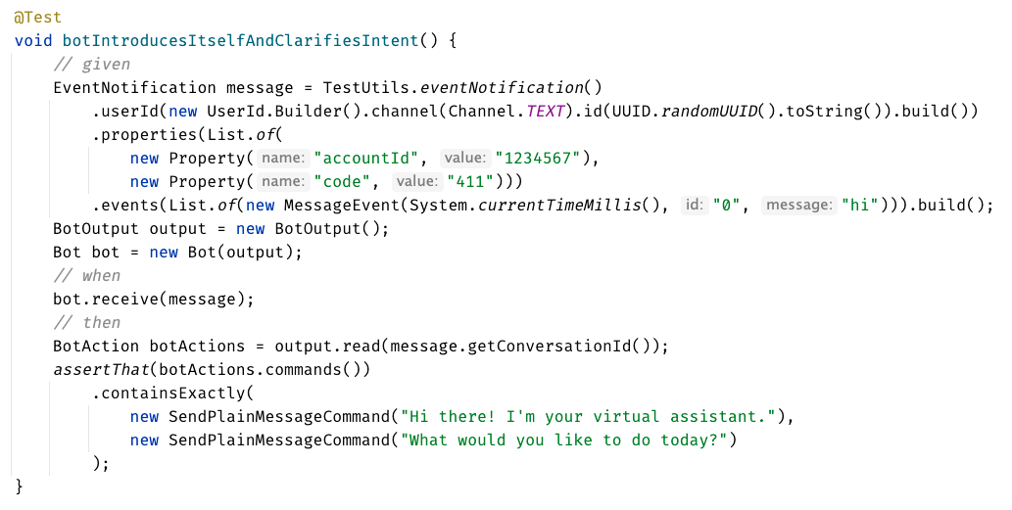

Slide 20
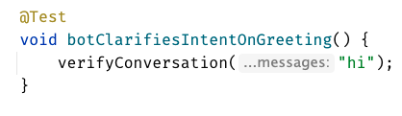
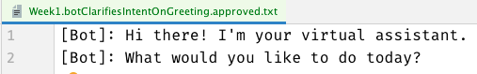

Slide 22
Week 1
learnings
Convenience Functions
ApprovalTests
Testing Circle
verifyConversation("hi");
Notes:
Pay attention to the testing circle
Create convenience functions to hide unnecessary details

Slide 23
...later next week...

Slide 24
code

Slide 25
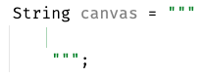
New Concept:
Story Board

Slide 26
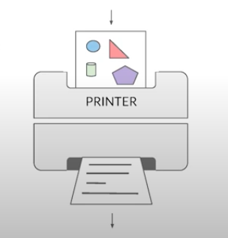
New Concept:
Printers
@EmillyBache

Slide 27
Chat
[Customer]
hi
[Bot]
Hi there! I'm your virtual assistant.
What would you like to do today?
[Customer]
pay bill
[Bot]
Are you a customer?
Yes, I'm a customer No, I'm not

Slide 28
Problem:
Lack of clarity in the test code output

Slide 29
[Customer]: hi [ Bot]: Hi there! I'm your virtual assistant. [ Bot]: What would you like to do today? [Customer]: pay bill [ Bot]: Let me try to help you. [ Bot]: { "content": { "type": "vertical", "elements": [ { "type": "text", "text": "Are you a customer?", "tooltip": "text tooltip" }, { "type": "horizontal", "elements": [ { "type": "button", "title": "Yes", "click": { "actions": [ { "type": "publishText", "text": "Yes, I'm a customer" } ] } }, { "type": "button", "title": "No", "click": { "actions": [ { "type": "publishText", "text": "No, I'm not" } ] } } ] } ] } }
Chat
[Customer]
hi
[Bot]
Hi there! I'm your virtual assistant.
What would you like to do today?
[Customer]
pay bill
[Bot]
Are you a customer?
Yes, I'm a customer No, I'm not

Slide 30
Week 1
What happened
Notes:
Pay attention to the testing circle
Create convenience functions to hide unnecessary details

Slide 31

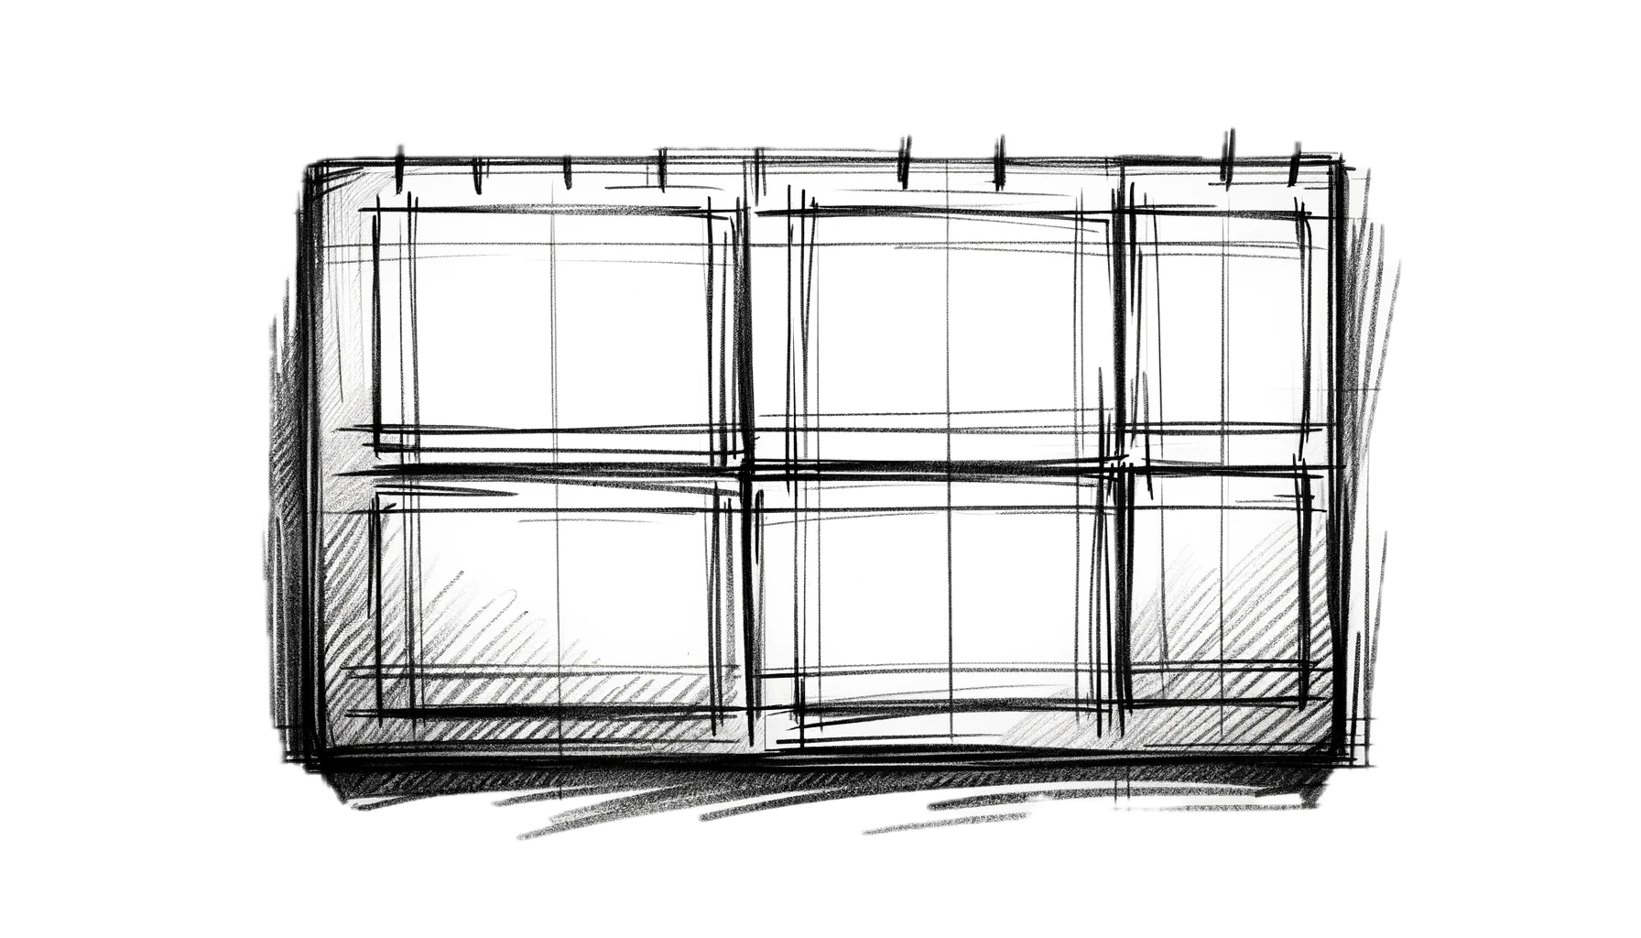
Complex
Tests
ApprovalTests
Testing Circle
Printers
+ Storyboard
JSON

Slide 32
Formatting
[Customer]: hi [Bot]: Hi there! I'm your virtual assistant. [Bot]: What would you like to do today?
[Customer]: hi [ Bot]: Hi there! I'm your virtual assistant. [ Bot]: What would you like to do today?

Slide 33
Formatting
[Customer]: hi [Bot]: Hi there! I'm your virtual assistant. [Bot]: What would you like to do today? [Customer]: hi [Bot]: Hmmm, tell me a little more so I can help you. What would you like to do today? [Customer]: hi [Bot]: Let me try to help you. [Bot]: Are you a customer? 1) Yes, I'm a customer 2) No, I'm not
[Customer]: hi
[ Bot]: Hi there! I'm your virtual assistant. [ Bot]: What would you like to do today? [Customer]: hi [ Bot]: Hmmm, tell me a little more so I can help you. [ ]: What would you like to do today? [Customer]: hi [ Bot]: Let me try to help you. [ Bot]: Are you a customer? [ ]: 1) Yes, I'm a customer [ ]: 2) No, I'm not

Slide 34
[Customer]: hi [ Bot]: Hi there! I'm your virtual assistant. [ Bot]: What would you like to do today? [Customer]: pay bill [ Bot]: Let me try to help you. [ Bot]: { "content": { "type": "vertical", "elements": [ { "type": "text", "text": "Are you a customer?", "tooltip": "text tooltip" }, { "type": "horizontal", "elements": [ { "type": "button", "title": "Yes", "click": { "actions": [ { "type": "publishText", "text": "Yes, I'm a customer" } ] } }, { "type": "button", "title": "No", "click": { "actions": [ { "type": "publishText", "text": "No, I'm not" } ] } } ] } ] } }
[Customer]: hi [ Bot]: Hi there! I'm your virtual assistant. [ Bot]: What would you like to do today? [Customer]: pay bill [ Bot]: Let me try to help you. [ Bot]: Are you a customer? [ ]: 1) Yes, I'm a customer [ ]: 2) No, I'm not

Slide 35
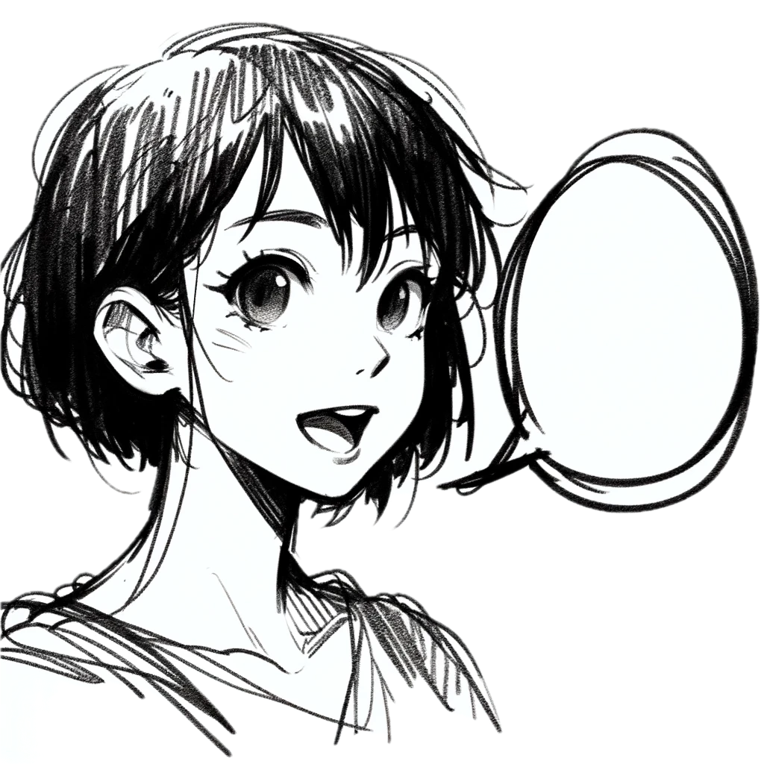
Week 2
learnings
Storytelling
Storyboard
Printers
Formatting
[Customer]: talk to an operator [ Bot]: Hi there! I'm your virtual assistant. [ Bot]: Let me try to help you. [ Bot]: Are you a customer? [ ]: 1) Yes, I'm a customer [ ]: 2) No, I'm not
Notes:
Pay attention to the testing circle
Create convenience functions to hide unnecessary details

Slide 36
...later next week...

Slide 37
code

Slide 38
Problem:
Too many .approved. files

Slide 39
New Concept:
Inline Approvals

Slide 40
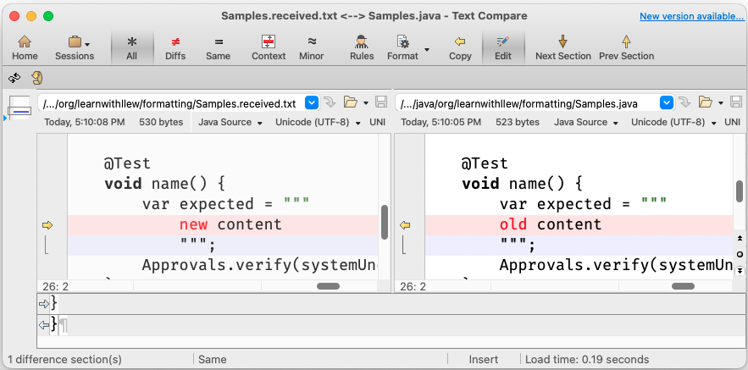
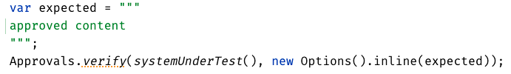
New Concept:
Inline Approvals
“Look mom, no files!”
Possible new source file
Original source file
Approved output
How to invoke
Pressing this modifies
your source code

Slide 41
Week 3
What happened
Notes:
Pay attention to the testing circle
Create convenience functions to hide unnecessary details

Slide 42
Complex
Tests
ApprovalTests
Testing Circle
Printers
+ Storyboard
JSON
Inline

Slide 43
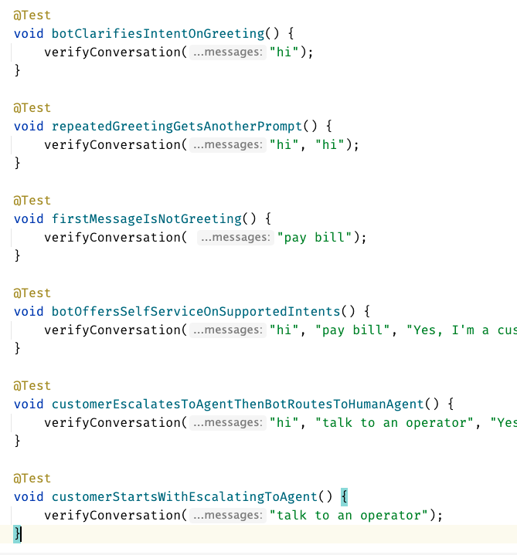
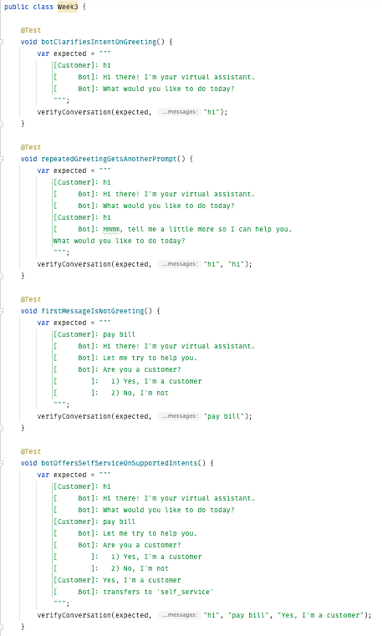
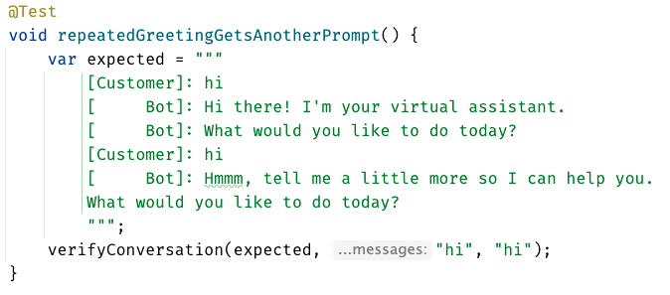
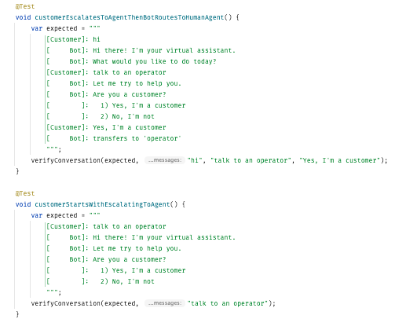
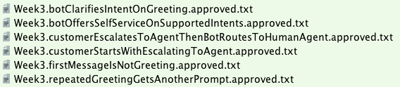

Slide 44
Week 3
learnings
Inline
Notes:
Pay attention to the testing circle
Create convenience functions to hide unnecessary details

Slide 45
...later next week...

Slide 46
code
Notes:
Hey Llewellyn, look what I did

Slide 47
Problem:
Can’t see the overall test strategy
hard to see if you’re missing cases...

Slide 48
New Concept:
verifyAll()

Slide 49
New Concept:
many of one

Slide 50
Week 4
What happened
Notes:
Pay attention to the testing circle
Create convenience functions to hide unnecessary details

Slide 51
Complex
Tests
ApprovalTests
Testing Circle
Printers
+ Storyboard
JSON
Verify all
Inline

Slide 52
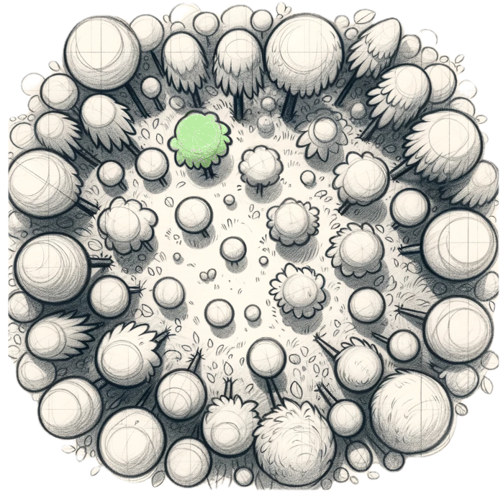
Week 4
learnings
Verify all
See the forest AND the trees
Notes:
Pay attention to the testing circle
Create convenience functions to hide unnecessary details

Slide 53
...later next week...

Slide 54
code
Notes:
Hey Llewellyn, look what I did

Slide 55
Problem:
95% of tests are together
but 5% are alone...

Slide 56
New Concept:
Custom test scenario builders
creating Domain-Specific Language (DSLs)

Slide 57
Week 5
What happened
Notes:
Pay attention to the testing circle
Create convenience functions to hide unnecessary details

Slide 58
Complex
Tests
ApprovalTests
Testing Circle
Printers
+ Storyboard
JSON
Verify all
Inline
domain DSL

Slide 59
var conversation1 = conversation("pay bill", "Yes, I'm a customer"); var conversation2 = conversation("pay bill"); var conversations = List.of(conversation1, conversation2);
conversation("pay bill", "No, I'm not") .thenConversation("pay bill")

Slide 60
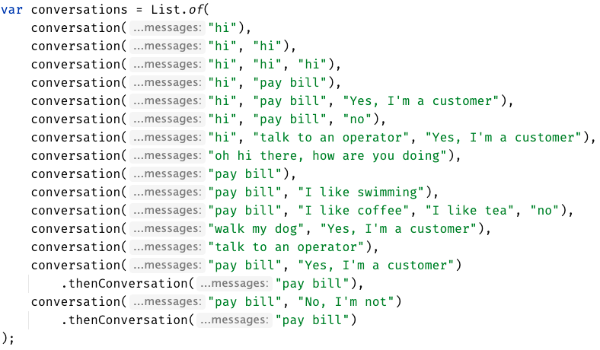

Slide 61
Week 5
learnings
See the forest AND the trees
(consistency)
Domain DSL
Notes:
Invest in APIs that make it easier to express test scenarios

Slide 62
...later next week...

Slide 63
code
Notes:
Hey Llewellyn, look what I did

Slide 64
New Concept:
Alternative .approved. files
new Options().forFile().withExtension(".md")
Notes:
stakeholders

Slide 65
Problem:
The tests are only for developers

Slide 66
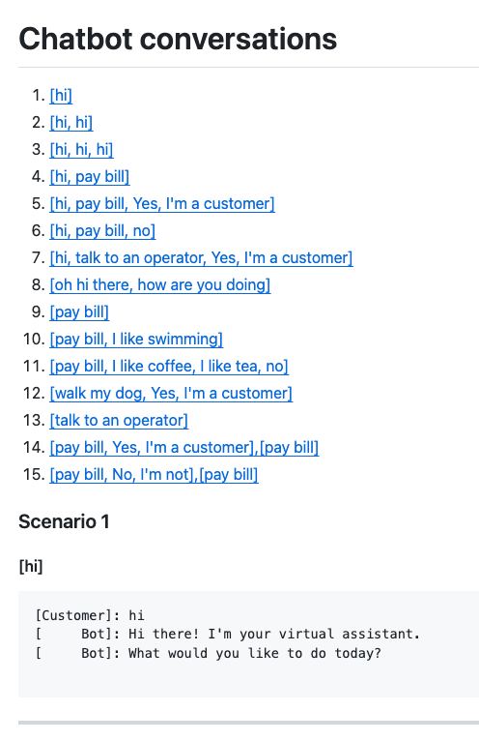
Complex
Tests
ApprovalTests
Testing Circle
Printers
+ Storyboard
markdown
Tests
work as Documentation
JSON
Verify all
Inline
domain DSL

Slide 67
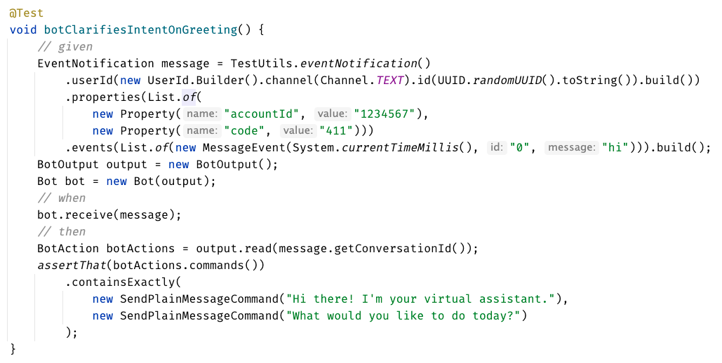
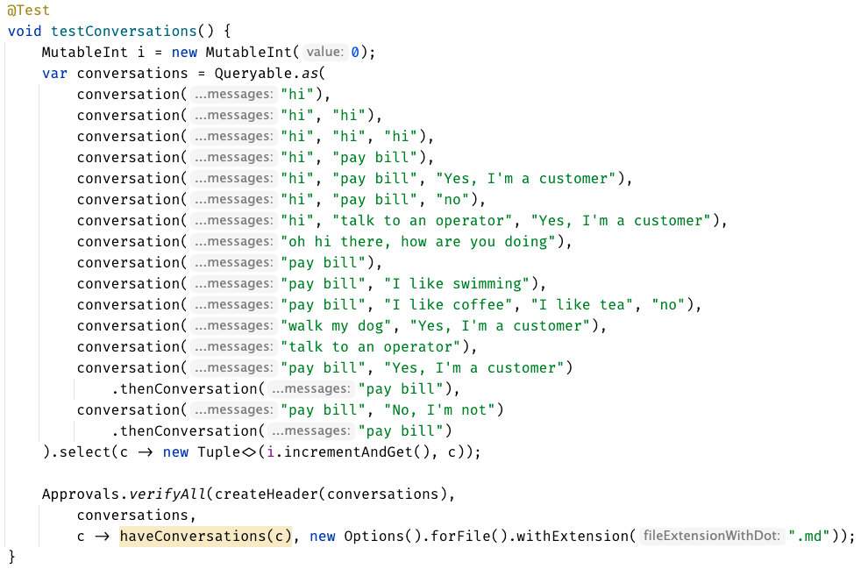

Slide 68
learnings
Storyboard
ApprovalTests
Storytelling
Testing Circle
Printers
Inline
Convenience Functions
verifyConversation("hi");
Domain DSL
See the forest AND the trees
Verify all
markdown
Notes:
Pay attention to the testing circle
Create convenience functions to hide unnecessary details

Slide 69
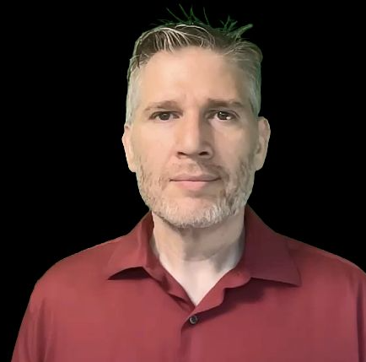
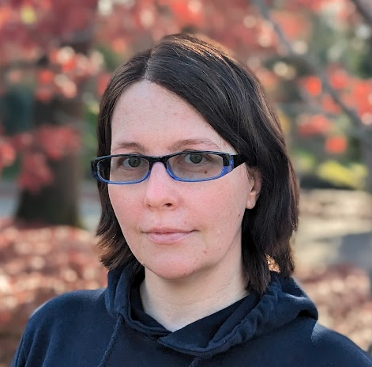
Resources
Thank you!
Llewellyn Falco
Lada Kesseler
Please connect on LinkedIn
Notes:
https://github.com/isidore/Talks/blob/master/BetterTestingWithApprovals.md

Slide 70
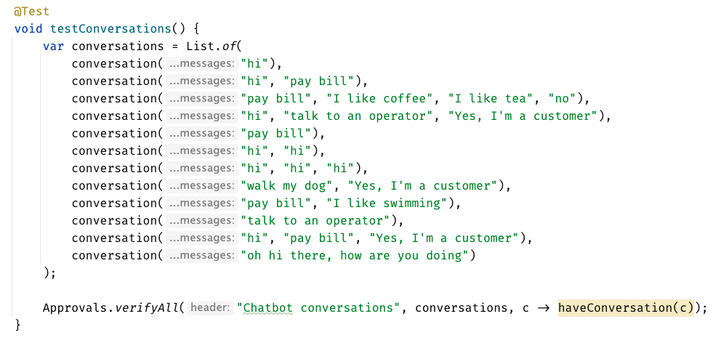

Slide 71
Chat
[Customer]
hi
[Bot]
Hi there! I'm your virtual assistant.
What would you like to do today?
Whiteboard
English
Testing Circle
Result
Code

Slide 72
Test.approved.txt
[Bot]: Hi there! I'm your virtual assistant. [Bot]: What would you like to do today?
Test.approved.txt
[Customer]: hi
[ Bot]: Hi there! I'm your virtual assistant. [ Bot]: What would you like to do today?

Slide 73
var expected = """ [Customer]: hi [ Bot]: Hi there! I'm your virtual assistant. [ Bot]: What would you like to do today? """; verifyConversations(expected, "hi");

Slide 74
var conversations = List.of( conversation("hi"), conversation("hi", "hi"), conversation("hi", "hi", "hi"), conversation("hi", "pay bill"), conversation("hi", "pay bill", "Yes, I'm a customer"), conversation("hi", "pay bill", "no"), conversation("hi", "talk to an operator", "Yes, I'm a customer"), conversation("oh hi there, how are you doing"), conversation("pay bill"), conversation("pay bill", "I like swimming"), conversation("pay bill", "I like coffee", "I like tea", "no"), conversation("walk my dog", "Yes, I'm a customer"), conversation("talk to an operator") );
conversation("pay bill", "No, I'm not") .thenConversation("pay bill")

